Slide 1

ENSE 470, Milestone 6
Tiger Vikings
Team members:
Samuel Iregbu
Christian Anwanaodung
Jay Denesik
Uys Kriek
March 29th, 2018

Slide 2
Technology Used:
No longer Using CSV
Switched to mySQL
Coded using C#
MS paint

Slide 3
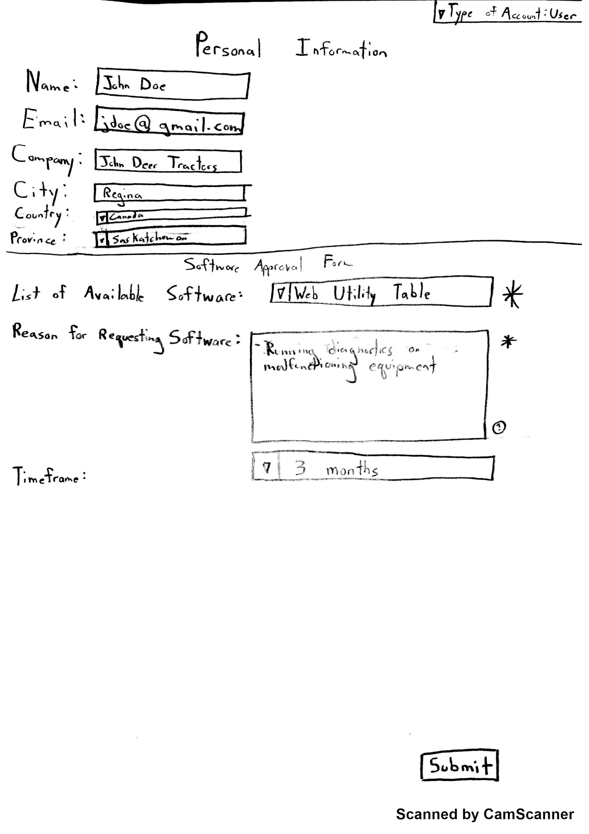
Retrospect: Lo-Fi Prototypes
Software Request Webform

Slide 4
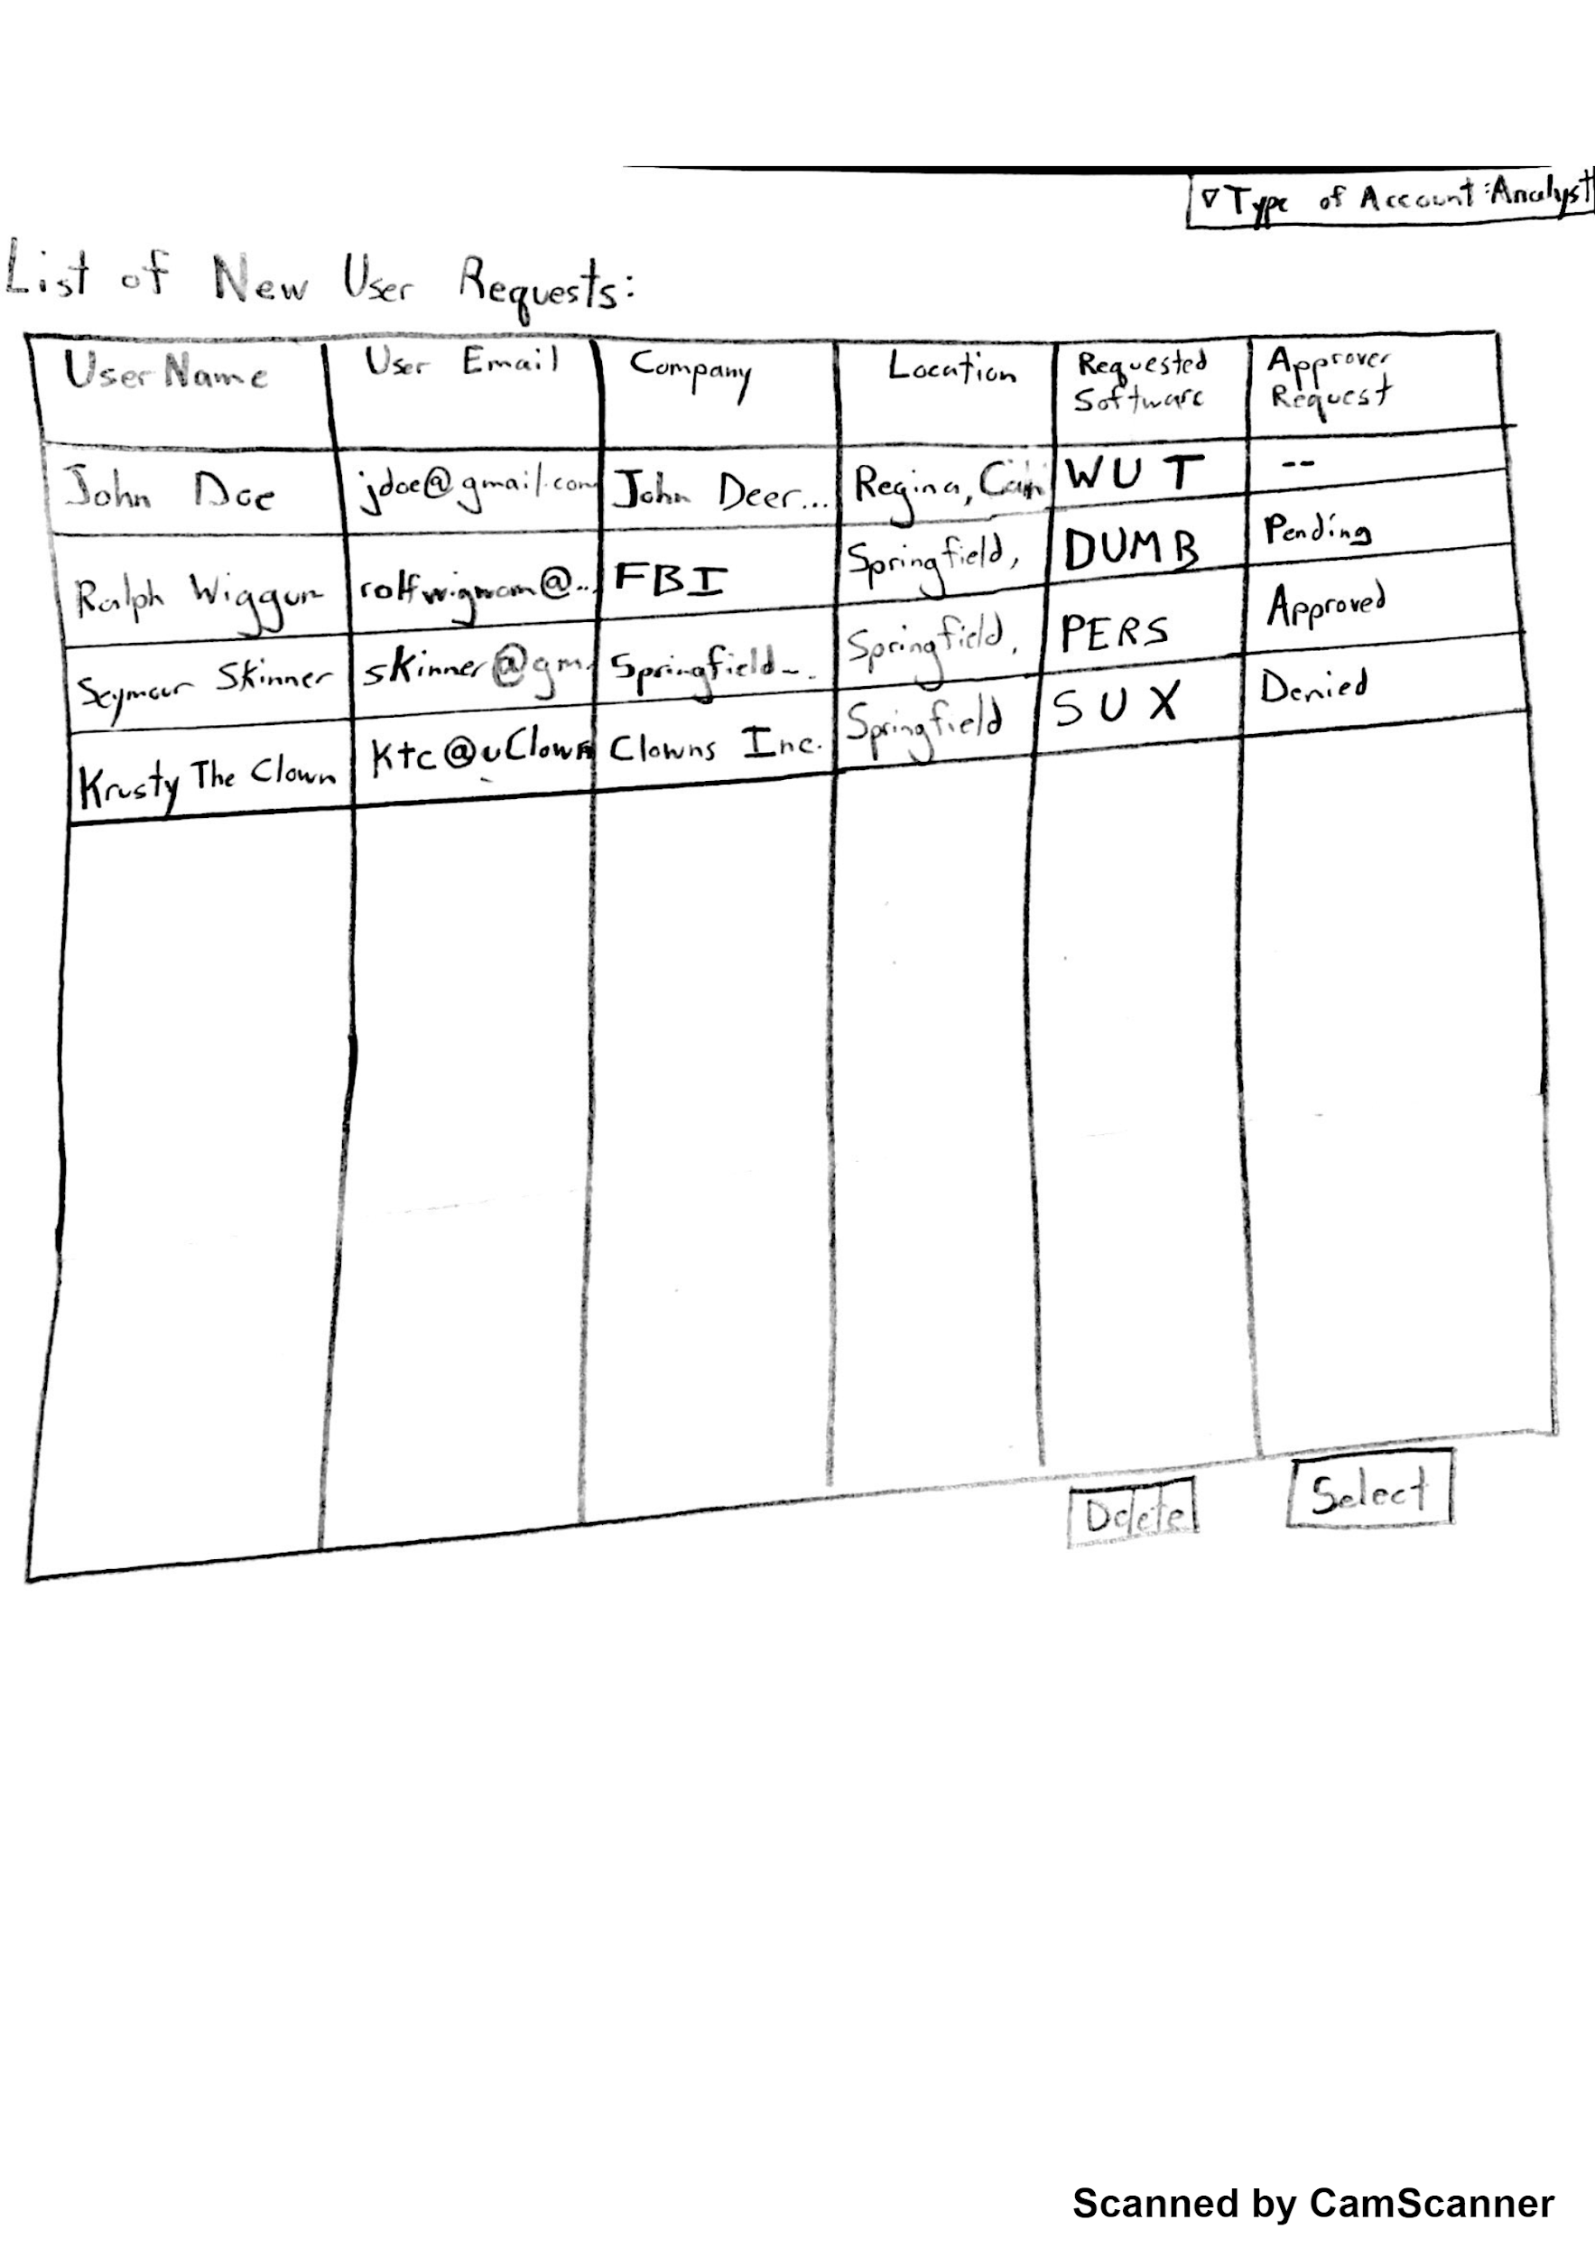
Retrospect: Lo-Fi Prototypes
Analyst Request Table

Slide 5
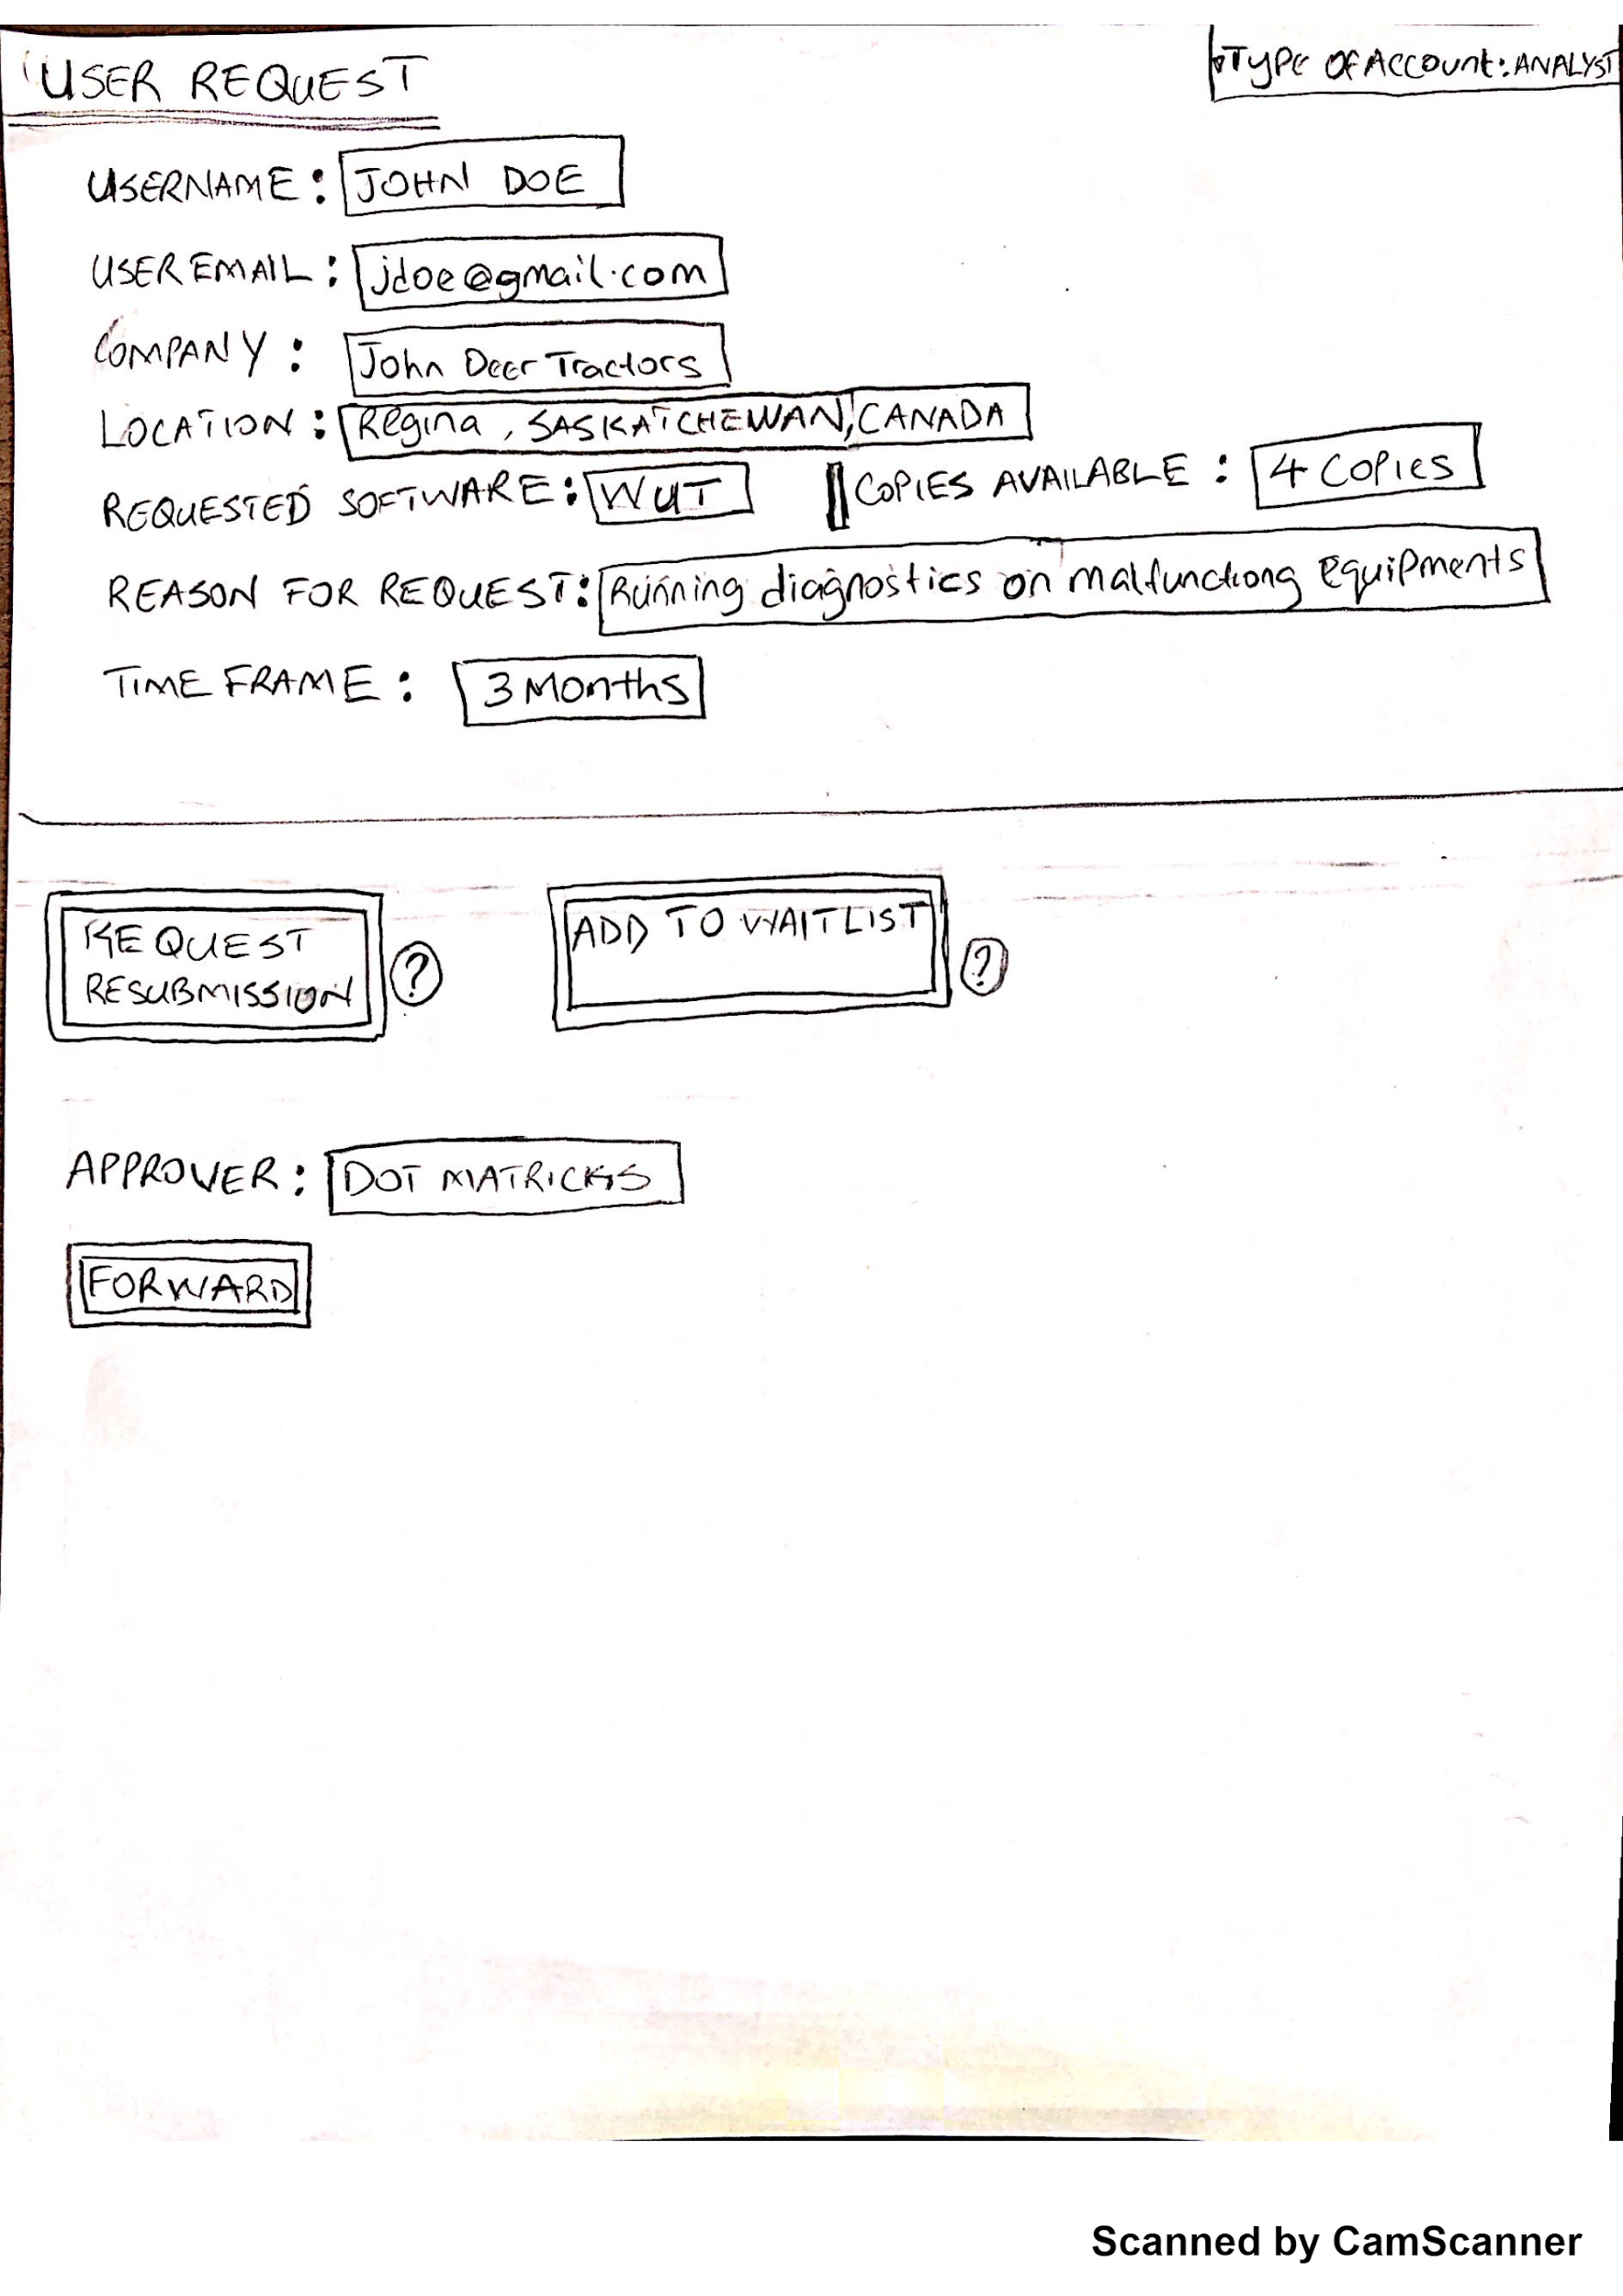
Retrospect: Lo-Fi Prototypes
User Request (Detailed View)

Slide 6
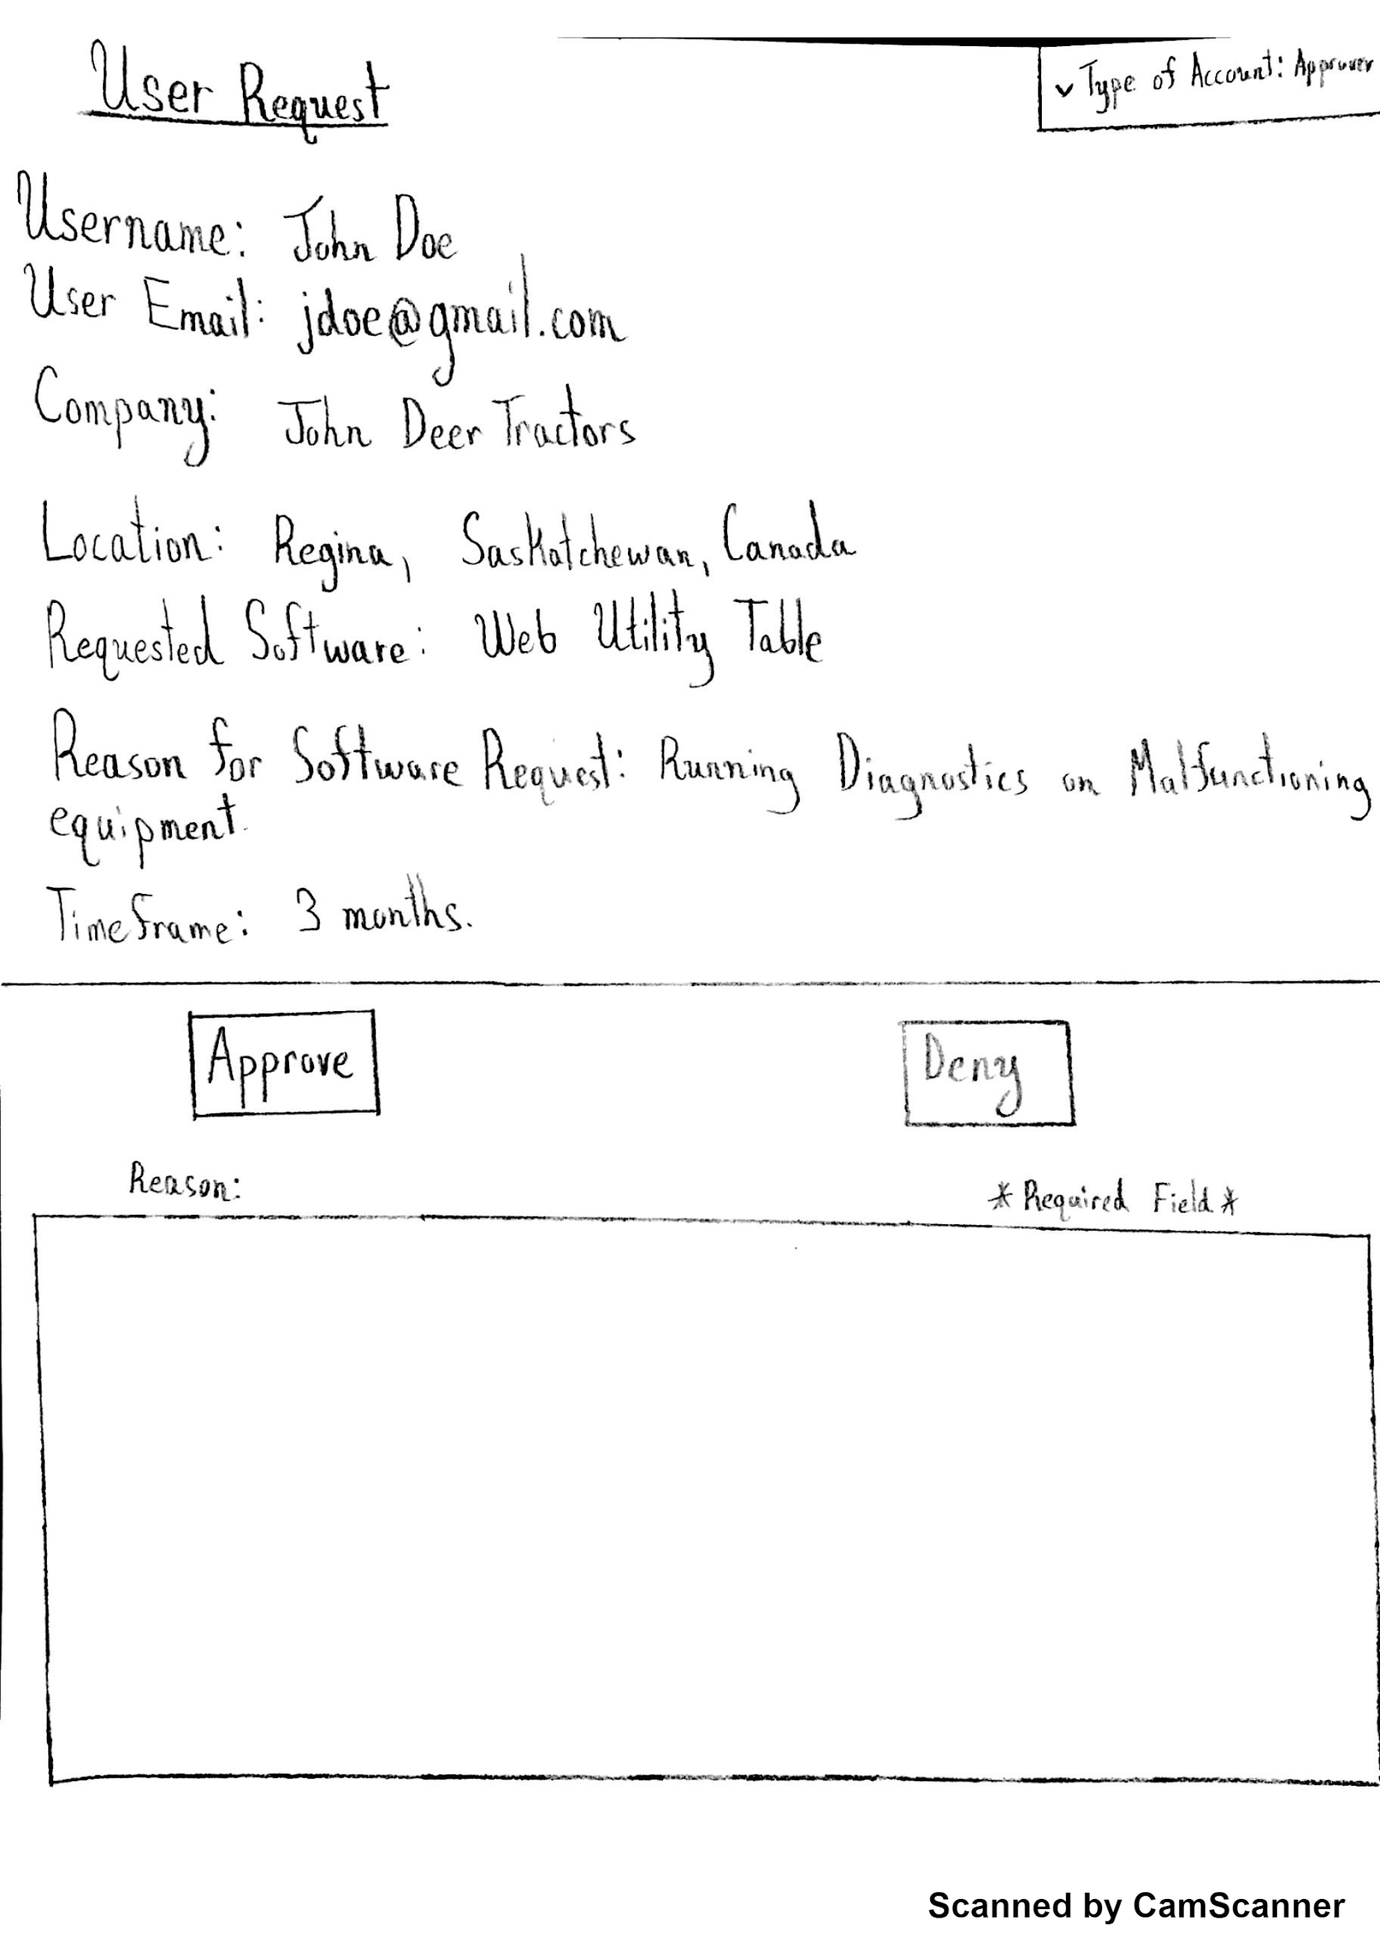
Retrospective: Lo-Fi Prototypes
User Request (Approver View)

Slide 7
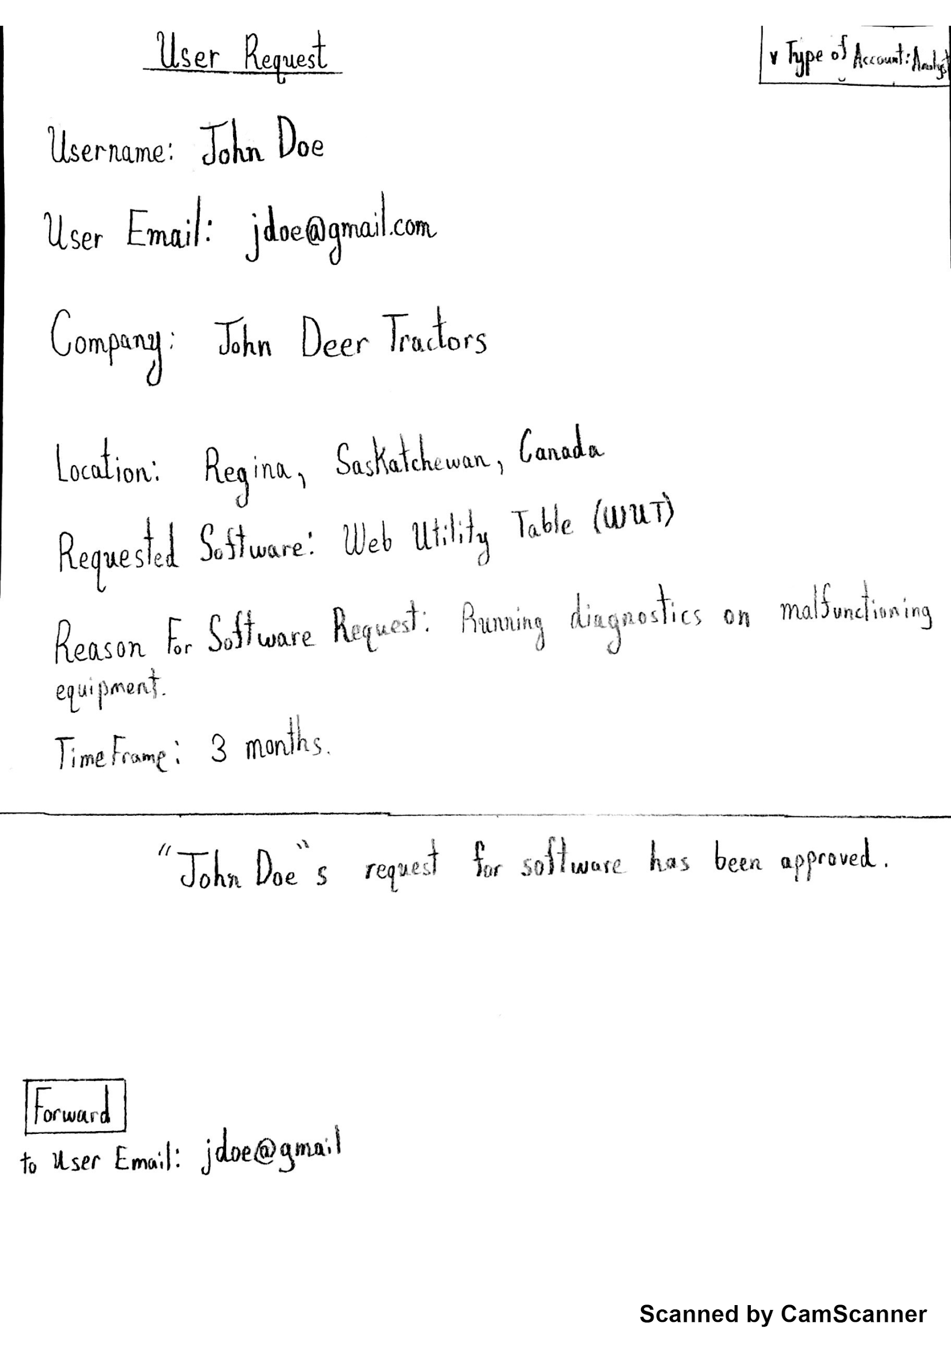
Retrospective: Lo-Fi Prototypes
User Request Finalization

Slide 8
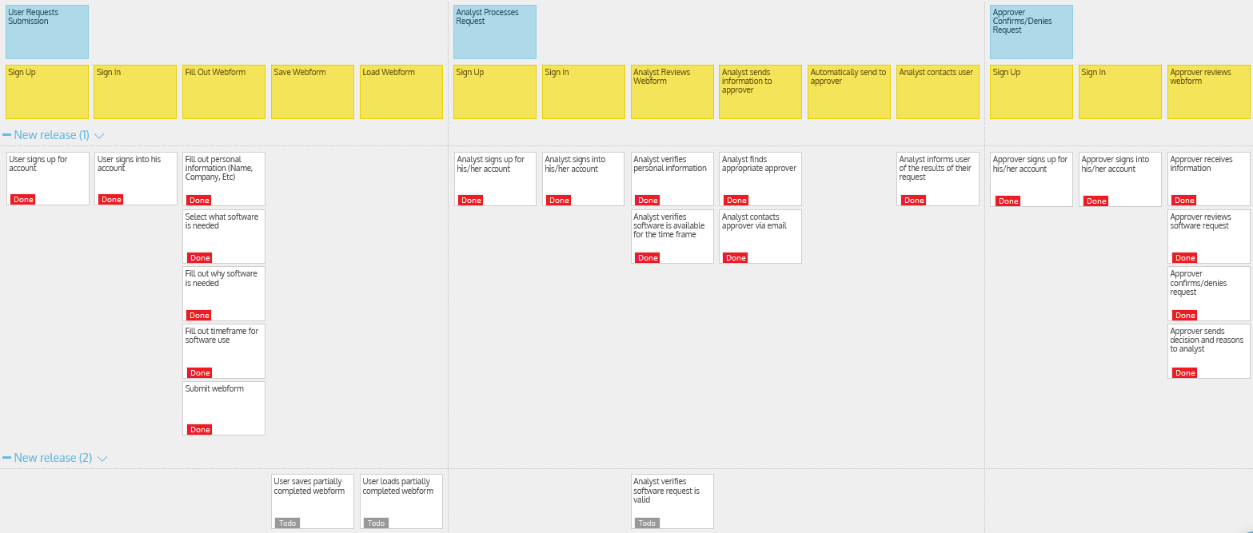

Slide 9
Design Patterns Used
Model View Controller (MVC)
Observer pattern

Slide 10
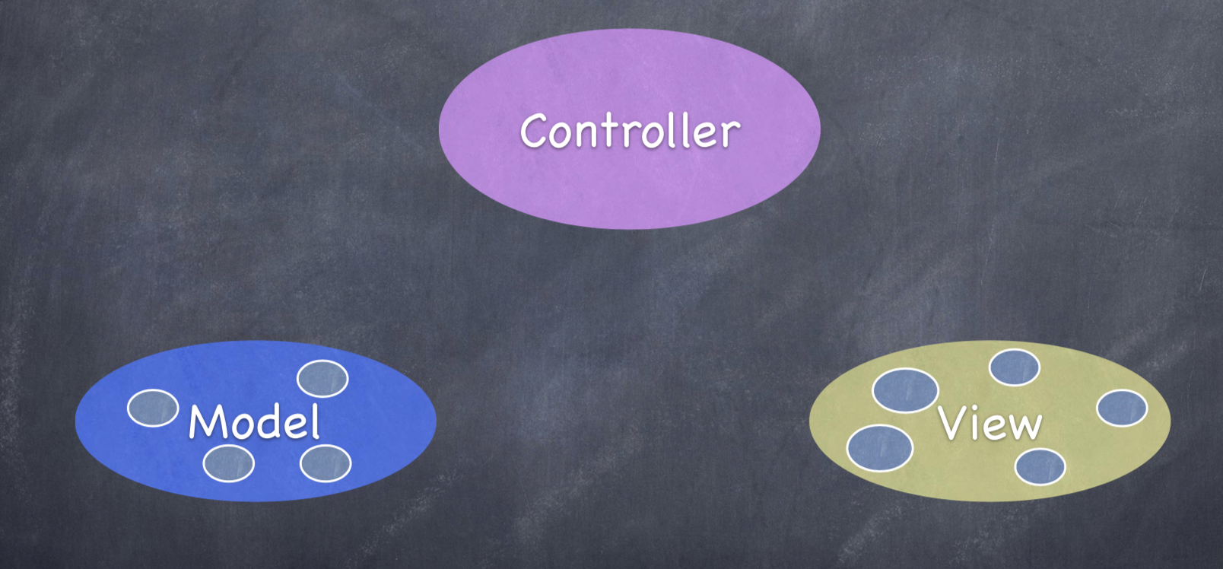

Slide 11
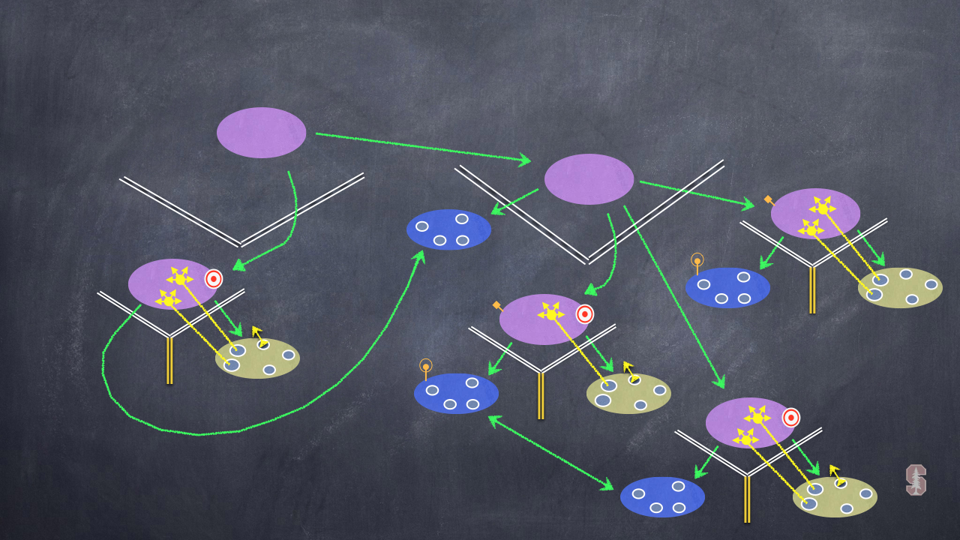
MVC’s WORKING TOGETHER

Slide 12
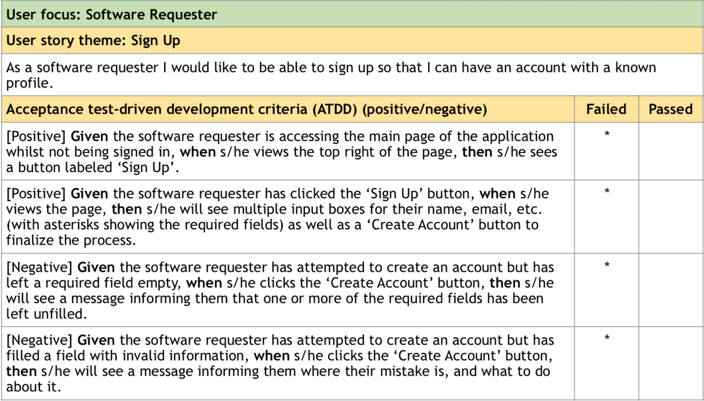

Slide 13
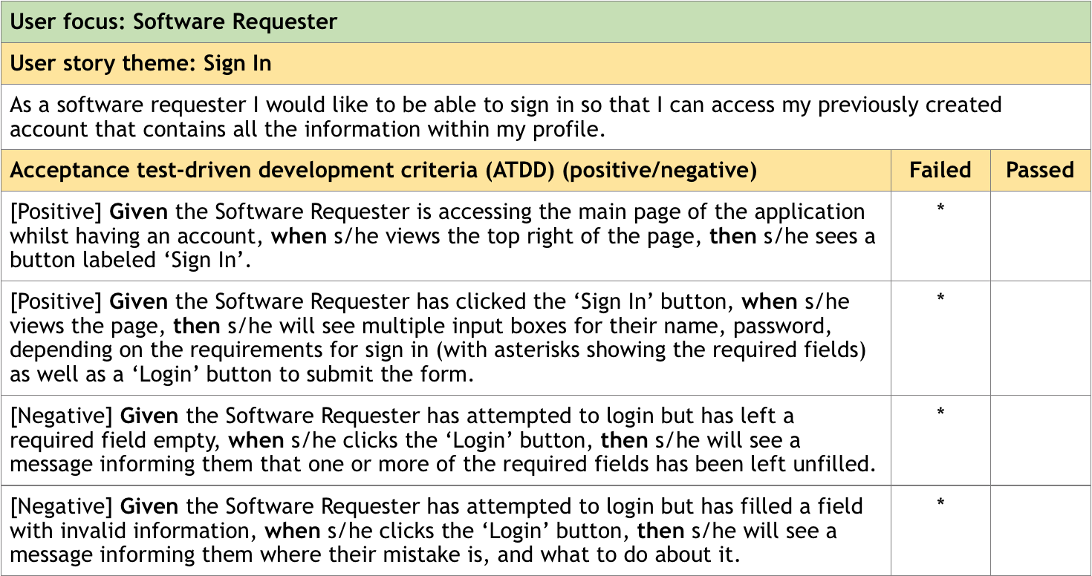

Slide 14
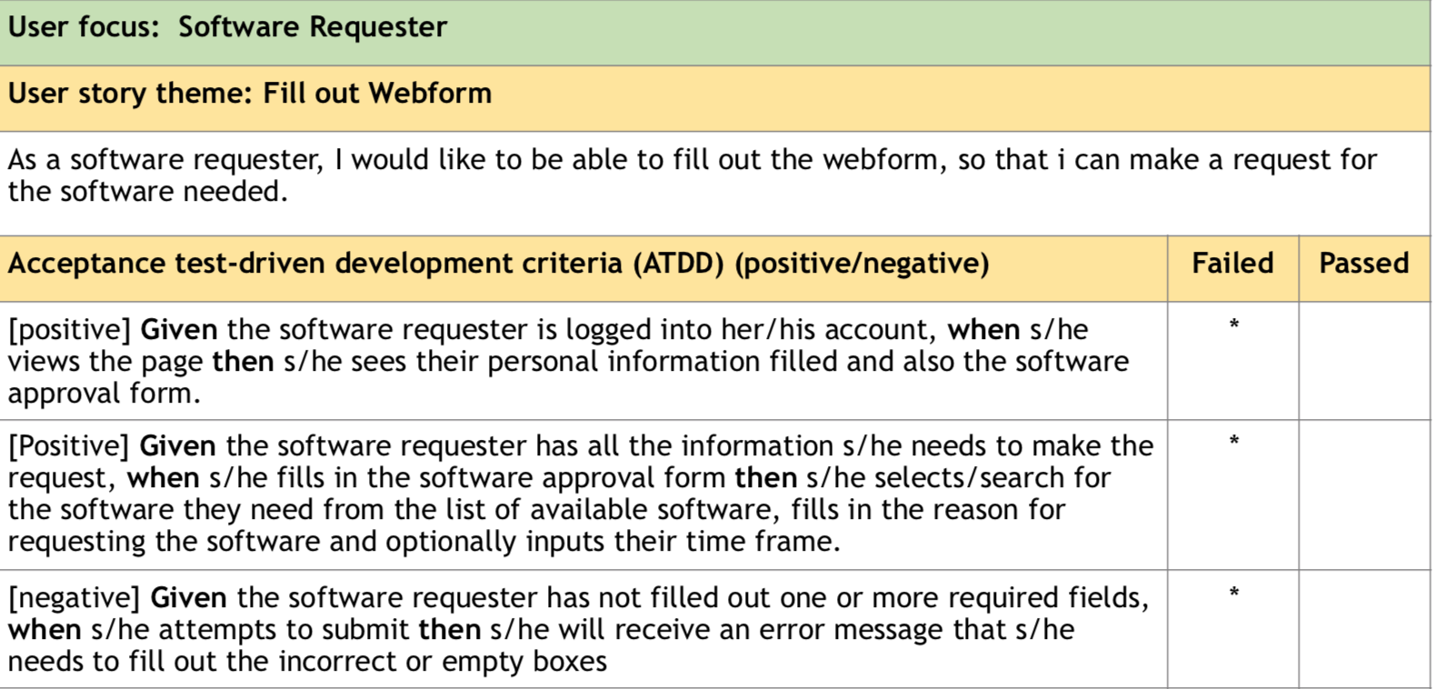

Slide 15
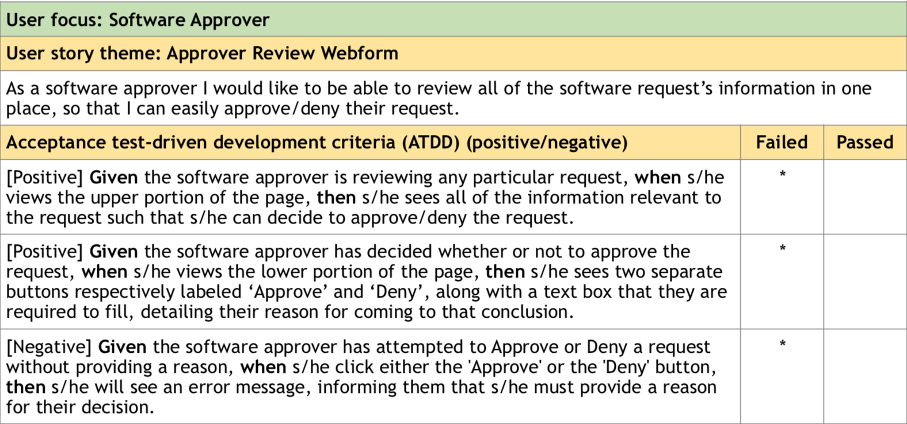

Slide 16
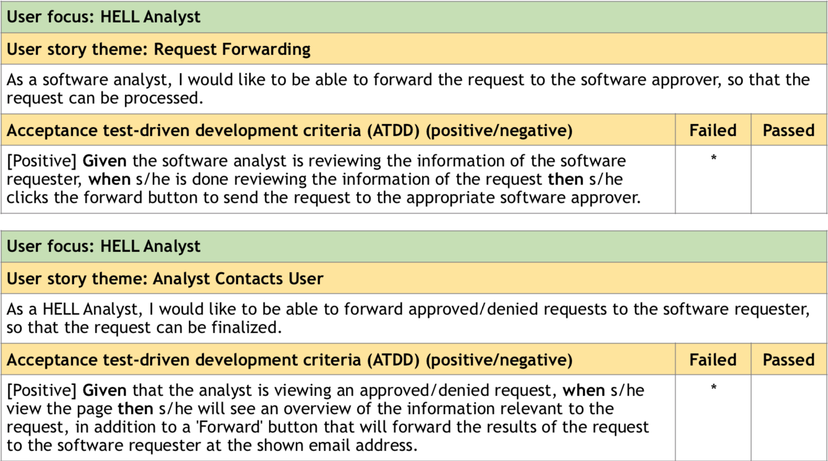

Slide 17
Minimum Viable Product Demo

Slide 18
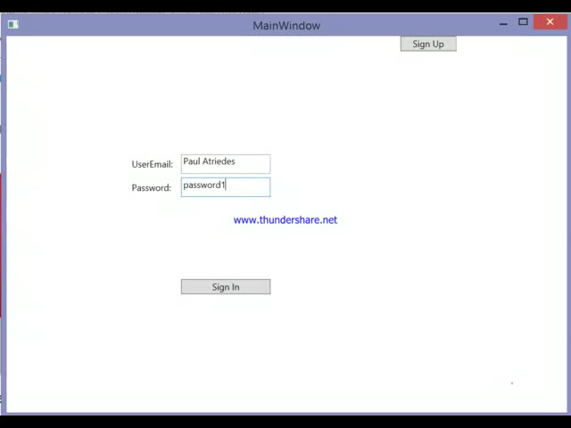

Slide 19
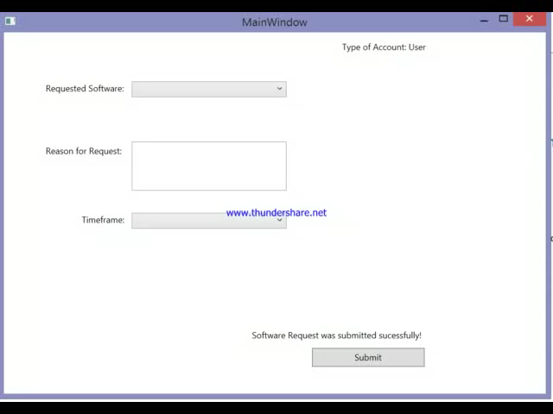

Slide 20
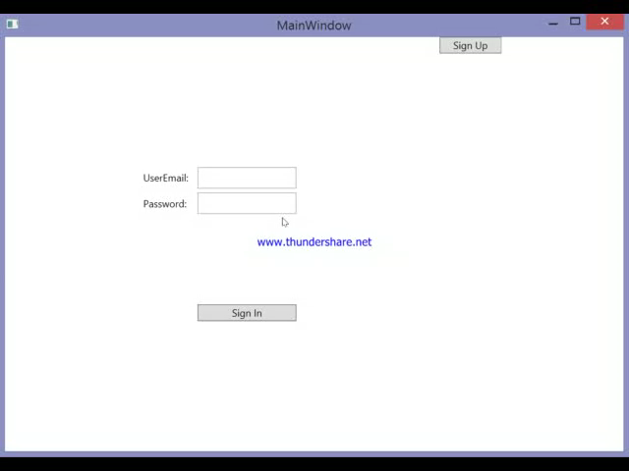

Slide 21
Group Reflection
How did you feel about this milestone? What did you like about it? What did you dislike?
We felt that this milestone helped us conclude our MVP development cycle.
What did you learn about yourself as you collaborated and worked through this milestone?
We learned to trust that each other would be able to complete their work separately
How will you use what you have learned going forward?
The experience of having completed a development cycle will make future development cycles much easier.
What “stuff & things” related to this milestone would you want help with?
Nothing in particular.

Slide 22


